Slide 1
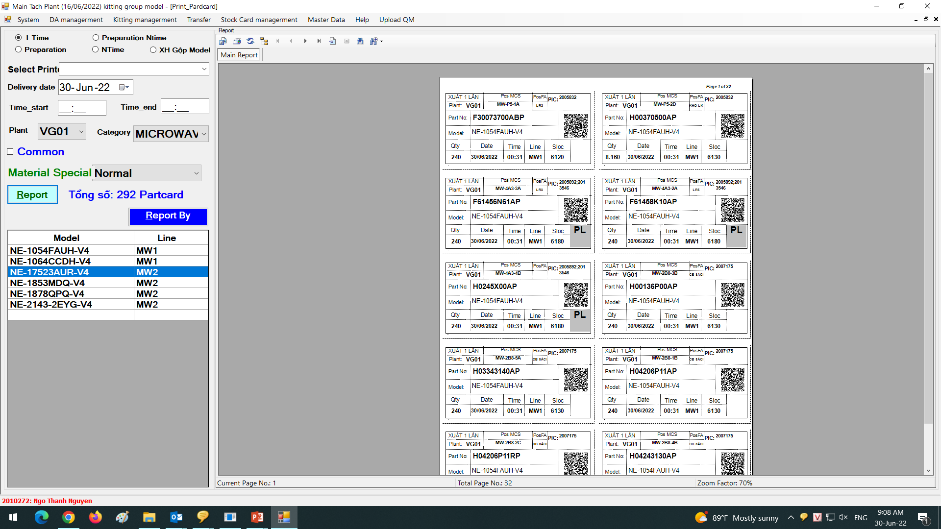
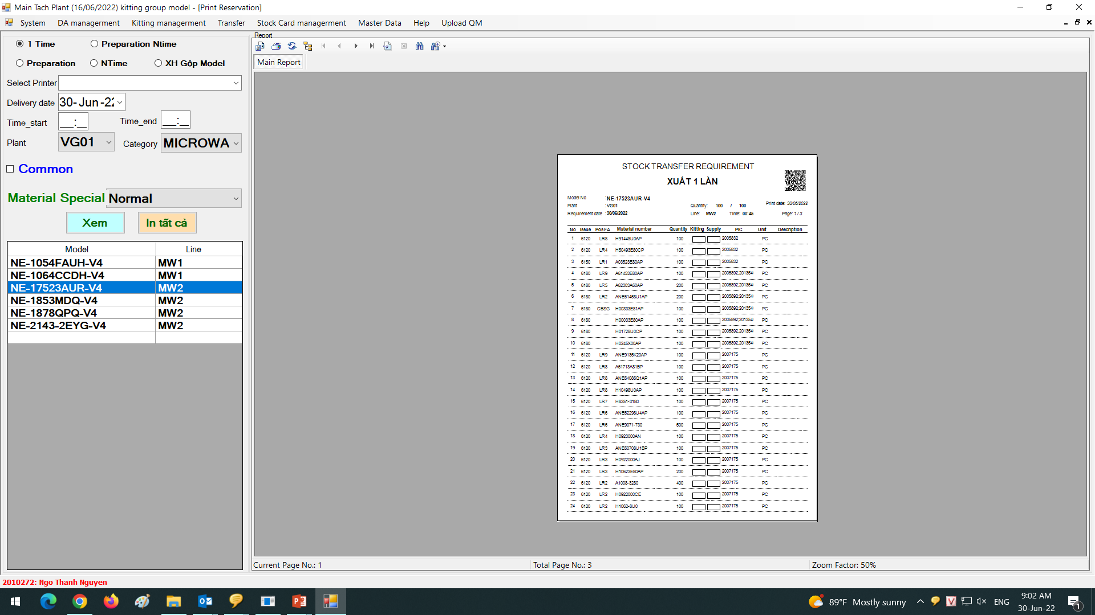
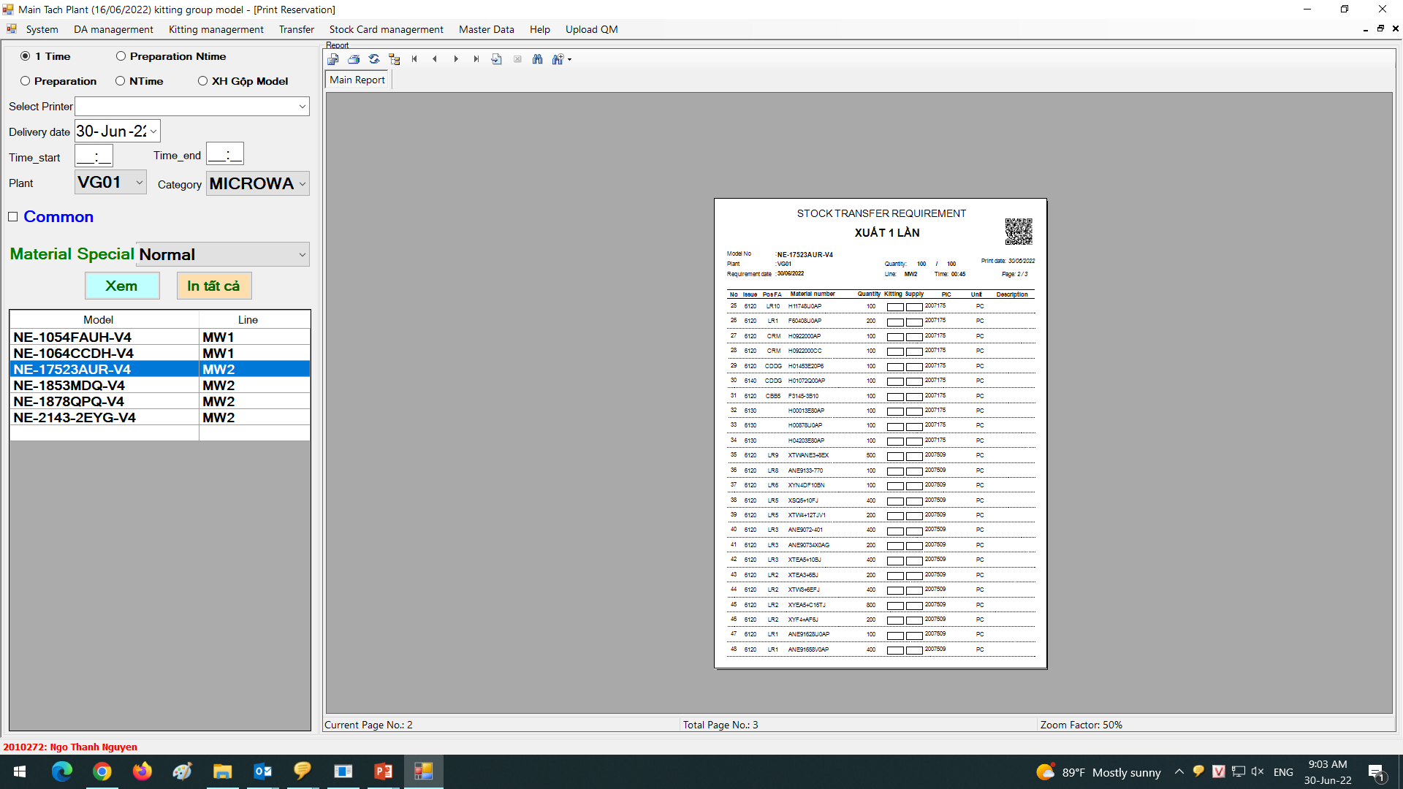
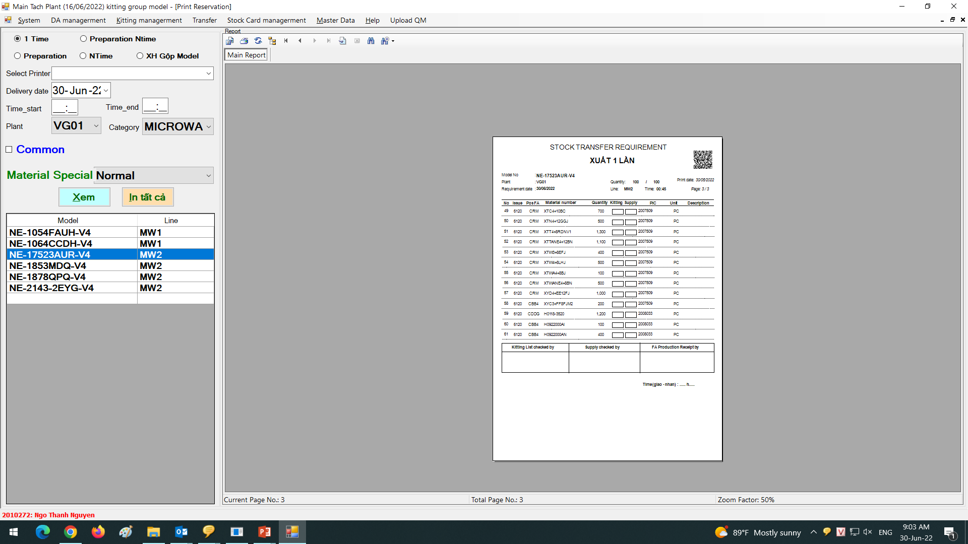


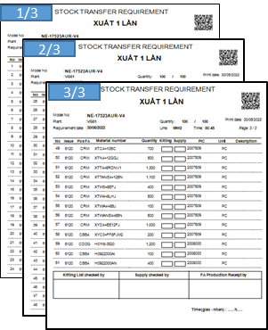
Improver printing list & part card by model & table assemble (MW &PJ)
BEFORE
AFTER
Current :MW & PJ List & part card group model by model ( not separate by table assemble)
Improve : MW & PJ List & part card group model by model and table assemble
1 List
Table 1
1/3
List by table
Table 1
Part card
2/3
Table 1
Table 2
Table 1
Table 3
Table 1
Table 2
Table 3
Table 2
Table 1
Table 4
Table 1
Table 5
Table 1
Table 6
Table 2
Table 2
3/3
Part card
Table 3
Table 3
Table 4
Table 4
Table 5
-Easy control part on trolley supply
=>save time supply for FA
-One list control many trolley supply
-1 trolley many part supply for many table assemble
=>Loss time supply for FA
Table 6
Table 5
Table 6
Table 6
Table 6
Table 6
Table 6
Table 6
Table 6
Table 6
Table 6
Table 6
Table 6
Table 6
FA Line
( separate part by table assemble)
FA Line
( separate part by table assemble)
Table 1
Table 2
Table 1
Table 2
Table 1
Table 2
Table 1
Table 2
Table 3
Table 3
Table 4
Table 3
Table 4
Table 3
Table 4
Table 1
Table 2
Table 3
Table 1
Table 2
Table 3
Table 5
Table 6
Table 5
Table 6
Table 5
Table 6
Save time supply
Table 1
Table 2
Table 1
Table 2
Table 1
Table 2
Loss time supply
Table 4
Table 5
Table 6
Table 3
Table 4
Table 3
Table 4
Table 3
Table 4
Table 4
Table 5
Table 6
Supply
Table 4
Table 5
Table 6
Table 5
Table 6
Table 5
Table 6
Table 5
Table 6
Supply
1 list control many trolley supply, not separate by table FA
List and part card group by table assemble
Current :
Improve :
-Microwave & Projector print List & part card group model by model by 1 list have many part 60 -120 parts
on the list => 1 list have many trolley supply
-At FA line request MCS must separate part by table assembly
MCS loss time for find part and location when supply .
Tack time supply 2 min/trolley
-Microwave & Projector print List & part card group model by model and table assemble
-Trolley supply have part list group by table assemble
Easy control part on trolley table assemble , save time supply for FA
Reduce tack time : 1.5 min/trolley
MW 150 trolleys supply to FA,PJ 80 trolleys supply to FA (1 trolley reduce 0.5 min)
Save : (150+80) x 0.5 = 115 min/day

